Slide 1
.NET Internals
Brandon Minnick
Code Traveler, LLC
Notes:
Welcome to the .NET Internals module.
Big idea: every time your code hits an await, the rest of the method may resume on a different thread. So how does .NET keep "ambient" information (the current user, the current culture, the HttpContext) attached to your operation while the thread underneath it changes? That is what we are going to inspect.
We will look at five building blocks. The challenges follow the same order; AsyncLocal<T> is covered inside the ExecutionContext challenge:
1. [ThreadStatic]: data that belongs to a thread, and why that breaks with async.
2. AsyncLocal<T>: the same idea attached to the job instead of the thread, so the value follows your code across an await.
3. ExecutionContext: the container .NET uses to flow ambient data (AsyncLocal<T>, culture, principal) across threads, plus how to capture, run and suppress it.
4. Principal: the identity of the current user, and how it survives an await.
5. SynchronizationContext: the mechanism that decides WHERE a continuation runs, and how ConfigureAwait(false) changes that.
By the end you should be able to look at any value after an await and answer: did this flow with the ExecutionContext, did it stay behind on the old thread, or was it just an object reference I already held? The last slide is a cheat sheet for exactly that question.

Slide 2
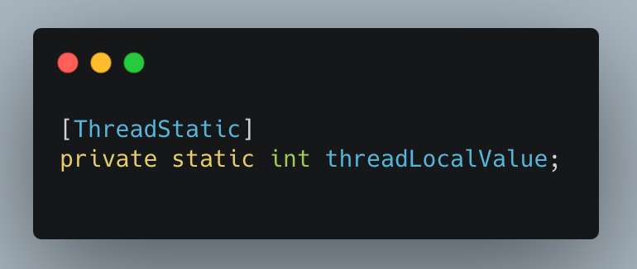
ThreadStatic
[ThreadStatic]
Stores Thread-specific data
Allowed on static fields
Security Concerns
  Data leaks caused by re-used Threads in ASP.NET Core
  Tasks may continue on different threads
  Use HttpContext instead
Notes:
[ThreadStatic] turns a static field into "one copy per thread." Every thread that touches the field sees its own independent value, and no thread can see another thread's value.
Bullet by bullet:
• Stores thread-specific data: the CLR allocates a separate slot for the field on each thread. In the sample, the main thread sets _threadSpecificValue = 100 and each background thread assigns its own random number. Neither background thread overwrites the main thread's 100.
• Allowed on static fields: the attribute only works on static fields; on an instance field it has no effect. Also, a field initializer (for example "= 100") runs only once, on the first thread that touches the type. Every other thread starts at default(T). That is why the sample assigns the value explicitly inside each thread.
• Security concerns: thread-static data is dangerous on servers because threads are recycled. A Thread Pool thread that served request A will later serve request B, and any [ThreadStatic] data left behind is now visible to request B. Tasks also hop threads across an await, so a value set before the await may simply be gone afterwards. Prefer request-scoped state such as HttpContext, or something that flows with the operation (AsyncLocal<T>, next slide).
Why this matters for the challenge: "1. ThreadStatic" is the baseline. You are proving to yourself that the data is bound to the THREAD. Every other topic in this module is about data that is bound to the logical OPERATION instead, so it can follow the operation across threads.
Handy APIs in the sample: Environment.CurrentManagedThreadId is a cheap way to print which thread you are on. thread.Join() blocks the caller until that thread finishes, which is how the sample waits for both background threads before printing the main thread's value again.
References:
https://learn.microsoft.com/dotnet/api/system.threadstaticattribute
https://github.com/dotnet/runtime/blob/main/src/libraries/System.Private.CoreLib/src/System/Threading/AsyncLocal.cs

Slide 3
ExecutionContext
“Digital Backpack”
Stores + Carries Data Across Async Hops
Attached to Task
  Loaded to the thread before execution
Immutable
Can be suppressed
  `ExecutionContext.SuppressFlow()` + `ExecutionContext.RestoreFlow()`
Notes:
ExecutionContext is the answer to "how does .NET carry ambient data across an await when the thread changes?" Think of it as a backpack of ambient values that is attached to the logical operation rather than to any physical thread. When the work moves to another thread, the backpack moves with it.
Bullet by bullet:
• Stores data specific to a (logical) thread: in .NET Core everything inside it is an AsyncLocal<T> value.
- Security information: Thread.CurrentPrincipal (the current user) and Windows impersonation.
- Culture information: CultureInfo.CurrentCulture / CurrentUICulture. The setter writes to an AsyncLocal whose change callback copies the culture into a thread-static on whichever thread the context is restored.
- AsyncLocal<T> values: your own data. Declare a static AsyncLocal<T> field, set .Value, and that value follows the logical operation across every await, Task.Run and thread switch. "One value per logical operation" instead of [ThreadStatic]'s "one value per thread." Values flow DOWN into child tasks; changes made inside a child never flow back UP to the parent. In ASP.NET Core, IHttpContextAccessor.HttpContext is also an AsyncLocal underneath.
- History: in .NET Framework the ExecutionContext also carried the SynchronizationContext. In .NET Core / .NET 5+ it does NOT. The SynchronizationContext lives on the thread and is captured separately by the awaiter. That is why, in the last challenge, ConfigureAwait(false) drops the SynchronizationContext while the ExecutionContext keeps flowing.
• Attached to Task: when you call Task.Run, ThreadPool.QueueUserWorkItem, start a Timer or a Thread, or hit an await, .NET captures the current ExecutionContext and restores it on the thread that runs the continuation, right before your code executes. You write no code for this; it is automatic.
• Immutable: the context is copy-on-write. Setting an AsyncLocal value creates a NEW context for the current flow; anyone who captured the old one still sees the old values. That is why changes made inside a Task.Run never leak back to the caller.
• Can be suppressed: ExecutionContext.SuppressFlow() tells .NET "do not carry the backpack into the next task or thread I start." RestoreFlow(), or disposing the returned AsyncFlowControl, turns flowing back on. The next two slides cover Capture/Run and SuppressFlow in detail.
Why this matters for the challenge: in "2. ExecutionContext" you set a culture (es-ES), a principal and an AsyncLocal value on the main thread, then print them from a background Thread that assigns its own values, from ExecutionContext.Run(...) with the main thread's captured context (main thread values, same background thread), from Task.Run(...) (main thread values, flowed automatically) and from Task.Run(...) with flow suppressed (machine default culture, empty principal, empty AsyncLocal).
References:
https://medium.com/net-under-the-hood/hidden-workings-of-execution-context-in-net-43b491726c65
https://github.com/dotnet/runtime/blob/main/src/libraries/System.Private.CoreLib/src/System/Threading/ExecutionContext.cs
https://github.com/dotnet/runtime/blob/main/src/libraries/System.Private.CoreLib/src/System/Threading/Thread.cs

Slide 4
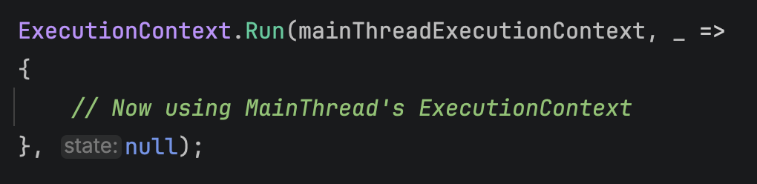
ExecutionContext
.Capture() + .Run()
Capture() snapshots the current context
  Returns null while flow is suppressed
Run executes code inside a stored ExecutionContext
  Same thread, different ambient values
  Previous context is restored when completed
await and Task.Run() do this for you automatically
Immutable: changes inside never leak back out
Notes:
This slide is "manual mode" for ExecutionContext. Normally .NET captures and restores the context for you; Capture() and Run() let you do it by hand, which is the clearest way to SEE what the runtime does behind every await.
Bullet by bullet:
• ExecutionContext.Capture() returns the current context: a snapshot of every AsyncLocal value (principal, culture, your own AsyncLocal<T>) at that moment. It returns null when flow is suppressed, which is why the sample writes "Capture() ?? throw ...".
• ExecutionContext.Run(context, callback, state) installs the snapshot on the CURRENT thread, runs your callback, then puts the thread's previous context back. The thread does not change; only the ambient values do. In the sample this runs on the background thread, which had just set its own culture, principal and AsyncLocal value, yet inside Run you see the MAIN thread's values, because that is what the snapshot contains.
• await, Task.Run(), ThreadPool.QueueUserWorkItem(), Timer callbacks and Thread.Start() all do exactly this pair of steps for you: capture on the way in, Run on the thread that executes the work. That is the whole mechanism behind "my principal survived the await."
• Immutable snapshot: because contexts are copy-on-write, anything the callback sets is stored in a new context and discarded when Run returns. The caller's values are unchanged, which you can verify in the sample when "Main Thread Values" are printed again after the background thread finishes.
Why this matters for the challenge: step 5 of "2. ExecutionContext" asks what changes when ExecutionContext.Run(...) is used. Answer: the thread is the same, but the ambient values are swapped for the ones in the captured snapshot, and swapped back afterwards. Step 6 asks what changes with Task.Run(...): the same thing happens, on a Thread Pool thread, without you writing any code.
Reference:
https://learn.microsoft.com/dotnet/api/system.threading.executioncontext

Slide 5
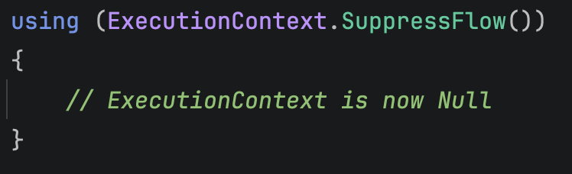
ExecutionContext
SuppressFlow()
SuppressFlow() stops the context flowing via async/await
  Tasks and Threads started while suppressed use the default context
When Suppressed, Threads Use Defaults
  AsyncLocal = null, Principal = null, Culture = machine default
Opt out for work that mustn’t inherit ambient state
Notes:
SuppressFlow() is the opt-out. Sometimes you start background work that should NOT inherit the caller's ambient state: a long-running cache refresh that must not hold onto a request's HttpContext, a fire-and-forget job that should not run as the current user, or simply to avoid the (small) cost of capturing the context.
Bullet by bullet:
• Calling ExecutionContext.SuppressFlow() marks the current thread's context as "do not flow." Any Task.Run, Thread Pool work item or Thread.Start() created while suppressed does NOT receive the caller's context; it runs with the default, empty context. Capture() returns null during this time.
• It returns an AsyncFlowControl struct. Disposing it (or calling Undo()) restores flow. The struct is thread-affine: it must be undone on the same thread that called SuppressFlow(), while flow is still suppressed on that thread; otherwise Dispose() throws InvalidOperationException.
• That constraint dictates the pattern you see in both samples: create the task INSIDE the using block, leave the block (flow is restored synchronously on the same thread), and only THEN await the task. If you awaited inside the using block, the continuation could resume on a different thread or with a different context, and the Dispose at the end of the block would throw.
• Inside the suppressed task every AsyncLocal-backed value is at its default: your AsyncLocal<T>.Value is null, Thread.CurrentPrincipal is null, IHttpContextAccessor.HttpContext is null, and CultureInfo.CurrentCulture is the machine default (for example "English (United States)") instead of the es-ES set on the main thread.
Two subtleties worth saying out loud:
• Suppressing flow only affects work that is STARTED while suppressed. It does not erase values on the current thread; you can still read them there.
• Suppression is about the ExecutionContext only. It does nothing to object references your code already holds. The recap slide at the end is all about that distinction.
Why this matters for the challenges: steps 7 and 8 of "2. ExecutionContext" ("why does the suppressed task see default values?" and "why is the task awaited only after leaving the using block?") are answered by this slide, and so is checkpoint 4 in "3. Principal".
Reference:
https://learn.microsoft.com/dotnet/api/system.threading.executioncontext.suppressflow

Slide 6
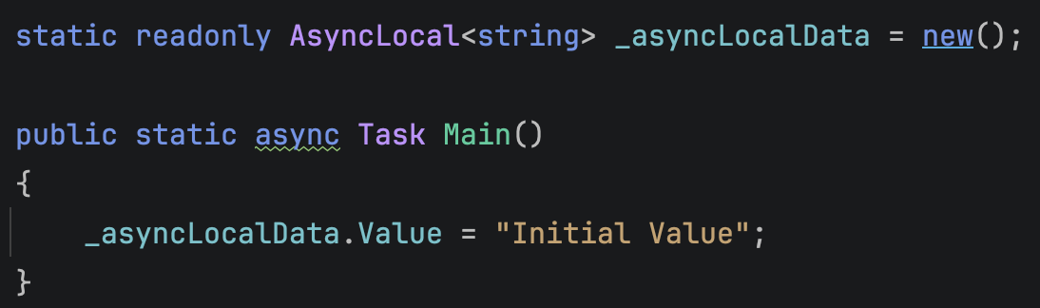
AsyncLocal<T>
Follows Async/Await, Not the Thread
One value per job, not per thread
  [ThreadStatic] follows the thread; AsyncLocal<T> follows async/await
Declare a static field, assign .Value
  Stored inside the current thread’s ExecutionContext
Child work gets a copy
  Task.Run and new Thread see it; their changes never come back
Examples: Principal, Culture and IHttpContextAccessor
Notes:
AsyncLocal<T> attaches a value to the work your program is doing instead of to the thread that happens to be running it. A "job" here means one request, one button click, one call to ProcessOrderAsync(...): the method that assigned the value, everything it awaits afterwards, and everything it starts. Those pieces may run on many different threads. The job is still one thing, and the value goes with it.
A picture that works in the room: a thread is a worker's desk, a job is a person carrying a backpack. [ThreadStatic] is a sticky note taped to the desk. After an await your job may resume at another desk, and the note stayed behind for the next job to find. AsyncLocal<T> is a sticky note inside the backpack. The backpack goes with the job from desk to desk, and every other job carries its own backpack. The next slide names the backpack: it is the ExecutionContext.
Bullet by bullet:
• One value per job, not per thread: assign _asyncLocalData.Value at the start of a job, then read it after an await that resumed on a Thread Pool thread, inside a Task.Run, or on a new Thread. It is still there. The thread changed; the job did not. Two jobs running at the same time each see their own value, even when they take turns on the same thread. Compare the previous slide, where a [ThreadStatic] value stays on the thread that assigned it.
• Declare a static field, assign .Value: the field is static and shared, but the value behind .Value is not; every job reads its own. It is default(T) (null for a string) until the job, or the job that started it, assigns one. Typical uses: a correlation id, the current tenant, a request id that logging should pick up without you threading it through every method signature.
• Child work gets a copy: when a job starts more work (Task.Run, a new Thread, a Timer callback), the child gets a copy of the backpack. It sees the parent's value, and if it assigns a new one, only the child and the work the child starts see it. When control comes back to the parent, the parent still has its original value. That is the copy-on-write behaviour of ExecutionContext on the next slide. It is also why you assign the value at the START of a job (top of the request, beginning of the background job) rather than deep inside a helper while expecting the caller to see it.
• Carried by ExecutionContext: the backpack is the ExecutionContext, and in .NET Core AsyncLocal<T> is the only kind of note it holds. Thread.CurrentPrincipal, CultureInfo.CurrentCulture / CurrentUICulture and ASP.NET Core's IHttpContextAccessor.HttpContext are all AsyncLocal<T> fields underneath. That is why they behave exactly like your own AsyncLocal values in the next two challenges ("2. ExecutionContext" and "3. Principal"): they survive an await, they flow into Task.Run, and they are gone inside work started with ExecutionContext flow suppressed.
Two details worth saying out loud:
• The note holds a reference, not a copy of the object. Assigning .Value is isolated per job, but if T is a mutable object (a List<T>, a Dictionary) and a child mutates it, the parent sees the mutation because both hold the same object. Prefer immutable values: a string, an id, a record.
• Cost: assigning a new value creates a new ExecutionContext (copy-on-write), and every await and Task.Run captures and restores it. A handful of AsyncLocal<T> fields assigned once per job is fine; assigning in a hot loop is not. The AsyncLocal<T>(Action<AsyncLocalValueChangedArgs<T>>) constructor adds a callback that runs whenever the value changes on a thread, including when a context is restored onto a new thread; CultureInfo uses it to copy the flowed culture into the thread's current culture. You will rarely need it.
Why this matters for the challenge: in "2. ExecutionContext" the main thread assigns _asyncLocalData.Value = "Initial Value". Predict what PrintThreadValues() prints for AsyncLocalData at each call: on the main thread right after the assignment ("Initial Value"), on the background Thread after it assigns its own value ("AsyncLocalData in Thread": it started with a copy of the main thread's backpack and wrote on its copy), inside ExecutionContext.Run(...) with the main thread's captured context ("Initial Value": the main thread's backpack was handed to that thread, so the backpack wins, not the thread), back on the main thread after Join() ("Initial Value": the thread wrote on its own copy, so nothing came back), inside Task.Run(...) ("Initial Value": the copy travelled automatically) and inside Task.Run(...) with flow suppressed (empty: it was handed an empty backpack). The next three slides are the "how" behind each of those.
References:
https://learn.microsoft.com/dotnet/api/system.threading.asynclocal-1
https://github.com/dotnet/runtime/blob/main/src/libraries/System.Private.CoreLib/src/System/Threading/AsyncLocal.cs

Slide 7
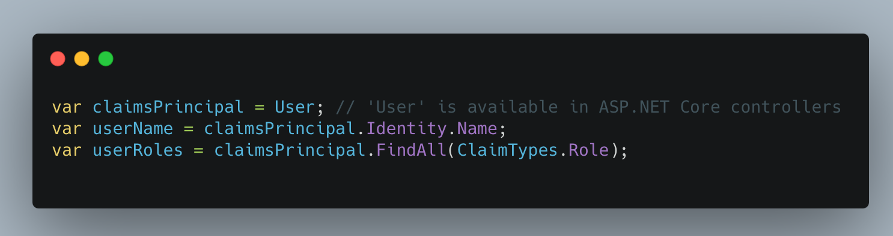
AsyncLocal<T>
System.Security.Principal
Identity
  Who is performing the action
  E.g. Name, AuthenticationType, IsAuthenticated
Roles and Claims
  What the user is allowed to do
Permissions
  What specific actions or resources the user is authorized to access
Notes:
Before we talk about how identity flows, let's agree on what "identity" is in .NET. The System.Security.Principal namespace models WHO is running the code and WHAT they are allowed to do.
Bullet by bullet:
• Identity: an IIdentity answers "who is this?" (Name, AuthenticationType, IsAuthenticated). ClaimsIdentity is the modern implementation: a bag of Claims such as Name = "Ada" or Role = "Admin". The sample's identity holds a single Name claim: the name you type when you sign in.
• Roles and Claims: an IPrincipal wraps an identity and answers "what can they do?" via IsInRole(...). ClaimsPrincipal is the modern implementation and can hold several identities. In the sample, AccountController.Login wraps the ClaimsIdentity in a new ClaimsPrincipal and signs in with it.
• Permissions: the concrete decision. Is this user allowed to hit this action or resource? ASP.NET Core's [Authorize] attribute and authorization policies make that decision using the principal.
Where you get the principal from:
• Thread.CurrentPrincipal: the "ambient" principal for the current logical operation. It is typed as IPrincipal; the sample stores a ClaimsPrincipal in it. In .NET Core this property is backed by AsyncLocal<T>, so it rides on the ExecutionContext and survives an await, even when the continuation lands on a different thread. It is null unless something set it.
• HttpContext.User, exposed as the controller's User property (the code screenshot): the request's principal, populated by the authentication middleware from the cookie or token. In ASP.NET Core this is the one you should normally use. ASP.NET Core never sets Thread.CurrentPrincipal for you. In the sample, checkpoint 1 shows it as null while HttpContext.User already holds the signed-in user, which is why RunExperiment() then assigns it by hand.
Why this matters for the challenge: in "3. Principal" you sign in with your own name, and HomeController.RunExperiment() copies HttpContext.User into Thread.CurrentPrincipal, then awaits Task.Yield(). That await never completes synchronously (ConfigureAwaitOptions.ForceYielding, covered later, gives an awaited Task the same guarantee), so the rest of the method runs as a scheduled Thread Pool work item, typically on a different thread. The results table shows the principal survive that switch, flow into Task.Run(...), and come back null inside a Task.Run(...) that was started with ExecutionContext flow suppressed.
References:
https://learn.microsoft.com/dotnet/api/system.security.claims.claimsprincipal
https://learn.microsoft.com/dotnet/api/system.threading.thread.currentprincipal

Slide 8
SynchronizationContext
Manages Asynchronous Code Execution
Used in UI Frameworks*
Controls Task Continuations
  Return to calling thread
When null, continuations use Thread Pool
Notes:
ExecutionContext answers "what ambient data does the continuation see?" SynchronizationContext answers a different question: "WHERE does the continuation run?"
Bullet by bullet:
• Used in UI frameworks*: WPF, WinForms and .NET MAUI install a SynchronizationContext on their UI thread, and Blazor installs one for its renderer. UI state can only be touched from one place at a time, so the framework needs a way to get work back there. SynchronizationContext.Post(callback) is that way: "run this on my context when you get to it." (The asterisk is because ASP.NET Core is the notable exception; see the following slides.)
• Controls Task continuations: when you await a Task, the awaiter looks at SynchronizationContext.Current. If it is non-null, it captures it and, when the task completes, Posts the rest of your method back to it. That is why, in a button click handler, the code after "await httpClient.GetAsync(...)" is back on the UI thread and can safely update a label, even though the HTTP work happened on the Thread Pool.
• When null, continuations use the Thread Pool: in a console app or an ASP.NET Core request, SynchronizationContext.Current is null. The awaiter has nothing to capture, so the continuation simply runs on whichever Thread Pool thread completed the task. That is cheaper, and it is why "which thread am I on after the await?" is unpredictable in those apps.
How to see it: SynchronizationContext.Current is a static property; inspect it in the debugger before and after an await. You will also see the concrete type (for example DispatcherSynchronizationContext in WPF, RendererSynchronizationContext in Blazor Server).
Key contrast to remember: the ExecutionContext ALWAYS flows across an await unless you suppress it. The SynchronizationContext is only captured when it is present AND you have not opted out with ConfigureAwait(false). The next four slides show where a SynchronizationContext does and does not exist in ASP.NET Core; then we come back to ConfigureAwait(false).
Reference:
https://github.com/dotnet/runtime/blob/main/src/libraries/System.Private.CoreLib/src/System/Threading/SynchronizationContext.cs

Slide 9
SynchronizationContext
*ASP.NET Core MVC
No SynchronizationContext in ASP.NET Core
UI Updates On Server
  HTML Sent to Browser for Rendering
Notes:
This is the first of the asterisk slides: what does SynchronizationContext look like outside a classic UI framework?
Bullet by bullet:
• No SynchronizationContext in ASP.NET Core: SynchronizationContext.Current is null while handling a request. This was a deliberate change from classic ASP.NET (System.Web), which had an AspNetSynchronizationContext that serialized continuations and re-attached HttpContext.Current to whatever thread ran them. Removing it made ASP.NET Core faster and eliminated a whole family of deadlocks (for example calling .Result on a Task inside a request).
• UI updates on the server: an MVC controller runs on the server and produces HTML. That HTML is sent to the browser, which renders it. There is no server-side "UI thread" to get back to, so there is nothing for a SynchronizationContext to protect.
Consequence for your code: with no context to capture, continuations run on whatever Thread Pool thread completes the awaited work. The thread ID before and after an await will usually differ, and ConfigureAwait(false) makes no practical difference in ASP.NET Core application code.
So how does request state survive an await if there is no SynchronizationContext? That is the ExecutionContext's job, and it is the topic of the next slide.

Slide 10
SynchronizationContext
*ASP.NET Core HttpContext
Contains Request / Response Information
  Eg Request headers, Cookies, Session
Scoped to the HTTP Request
  “Request-scoped services”
Retrieved via IHttpContextAccessor
Notes:
HttpContext is the per-request object in ASP.NET Core. Understanding how it is delivered to your code explains two of the four columns in the Principal challenge.
Bullet by bullet:
• Contains request / response information: Request (path, headers, cookies, body), Response, User (the ClaimsPrincipal set by authentication), Session, Items, RequestServices and more. Everything about one HTTP round-trip lives here.
• Scoped to the HTTP request: one HttpContext per request, created by the server when the request arrives and torn down when the response completes. Services registered with AddScoped live for the same window ("request-scoped services").
• Retrieved via IHttpContextAccessor: for code that is not a controller (services, helpers). Register it with builder.Services.AddHttpContextAccessor(). Internally HttpContextAccessor keeps the current HttpContext in a static AsyncLocal, so it flows with the ExecutionContext: available after an await on a different thread, null inside work started with flow suppressed, and null once the request has completed.
Two ways to reach the same object:
• Controller.HttpContext (and User, Request, Response): a property on the controller instance that reads the ControllerContext MVC assigned when it created the controller. It is an ordinary object reference. It is available inside a suppressed-flow Task.Run because the lambda captured "this", not because anything flowed. (Holding onto it after the request ends is a bug; the object is recycled.)
• IHttpContextAccessor.HttpContext: the ambient, AsyncLocal-backed version.
Why this matters for the challenge: in the "3. Principal" results table the httpContextAccessor.HttpContext?.User column shows null at checkpoint 4 (the Task.Run started with flow suppressed) while the HttpContext.User column still shows your name. Same HttpContext object, two very different delivery mechanisms.
Reference:
https://learn.microsoft.com/aspnet/core/fundamentals/http-context

Slide 11
SynchronizationContext
*Blazor Server
Does contain SynchronizationContext
  RendererSynchronizationContext: one item at a time, no dedicated UI thread
UI Updates On Server
  HTML Sent to Browser for Rendering
Client app connects to Server via SignalR
  Bidirectional communication via WebSocket protocol
User events sent to server for processing
  eg Button click
Notes:
Blazor Server is the one ASP.NET Core hosting model that DOES have a SynchronizationContext, and it is the setting for the last challenge.
Bullet by bullet:
• Does contain a SynchronizationContext: each user's circuit gets a RendererSynchronizationContext. It exists to serialize work: a component's lifecycle methods, event handlers and render operations for one circuit run one at a time, so component state does not need locks. Unlike WPF or MAUI there is NO dedicated UI thread; the queued work runs on ordinary Thread Pool threads. That is why the managed thread ID you see under this context does not have to be 1 and can change from one callback to the next. What stays constant is the context, not the thread.
• UI updates on the server: the component tree is rendered on the server, and only the diff of the DOM is pushed to the browser.
• Client connects via SignalR: a persistent, bidirectional WebSocket connection carries UI events up and render diffs down.
• User events sent to the server: a button click becomes a SignalR message; the server runs your handler on the circuit's synchronization context, re-renders, and pushes the diff back.
Getting back onto the context: ComponentBase.InvokeAsync(...) dispatches a delegate through the renderer's Dispatcher. If you are already on the circuit's synchronization context it runs inline; otherwise it is queued behind the current work. In the HackerNews sample, after leaving the context with ConfigureAwait(false), every StateHasChanged() and every mutation of TopStoryCollection is wrapped in InvokeAsync(...) to get back on it.
Why this matters for the challenge: in "4. SynchronizationContext" you should see a RendererSynchronizationContext before the first await, null after a ConfigureAwait(false) continuation, and the InvokeAsync(...) calls that marshal back for UI updates.
Reference:
https://learn.microsoft.com/aspnet/core/blazor/components/synchronization-context

Slide 12
SynchronizationContext
*Blazor WebAssembly
Does contain SynchronizationContext
UI updates via Browser’s Event Loop
  UI Components (.razor) each rendered independently
  Batches UI updates on the Render Queue
Notes:
Blazor WebAssembly runs your .NET code inside the browser, so the picture flips: there is no server round-trip for rendering, and the "UI thread" is the browser's main thread.
Bullet by bullet:
• Does contain a SynchronizationContext: in the browser, all DOM access and JavaScript interop must happen on the browser's main thread, and that is where Blazor's dispatcher runs component code. Blazor WebAssembly is single-threaded by default, so every continuation naturally lands back on that one thread and there is nothing to marshal.
• UI updates via the browser's event loop: rendering is driven by the browser's event loop rather than by a dedicated .NET UI thread. An awaited HTTP call is really a JavaScript fetch; when it completes, the event loop hands control back to .NET and your continuation runs.
• Components rendered independently: each .razor component tracks its own state and re-renders when that state changes.
• Batches UI updates on the render queue: instead of re-rendering on every state change, Blazor queues the affected components and applies them together in one render batch, then applies the resulting DOM diff.
Practical takeaway: in single-threaded Blazor WebAssembly, ConfigureAwait(false) does not move you to another thread; there is not one. The same code in Blazor Server WILL leave the renderer's synchronization context. That is why the HackerNews challenge runs on Blazor Server, where the difference is observable. ConfigureAwait(false) itself is the next slide.
Not part of the challenges; included so you have the complete picture of where SynchronizationContext shows up across ASP.NET Core.

Slide 13
SynchronizationContext
ConfigureAwait(false)
await captures SynchronizationContext.Current
  Continuation is posted back to it: UI thread, Blazor renderer
ConfigureAwait(false) skips the capture
  Continuation runs on a Thread Pool thread
  SynchronizationContext.Current is null afterwards
ExecutionContext still flows either way
Marshal UI work back explicitly
  Blazor: InvokeAsync(StateHasChanged); MAUI / WPF: Dispatcher
Notes:
ConfigureAwait(false) is the switch that controls the SynchronizationContext capture we saw on the SynchronizationContext slide.
Bullet by bullet:
• By default "await task" is the same as "await task.ConfigureAwait(true)": capture SynchronizationContext.Current (and the current TaskScheduler), and when the task completes, post the continuation back to it. In Blazor Server that means "back through the renderer's synchronization context"; in WPF or MAUI it means "back on the UI thread."
• ConfigureAwait(false) says "I do not need to come back to the captured context." Nothing is captured, so when the task completes the continuation runs inline on the thread that completed it, usually a Thread Pool thread. On that thread SynchronizationContext.Current is null. Library code uses this to avoid deadlocks and to avoid bouncing back to a UI thread for work that does not touch the UI.
• ConfigureAwait affects ONLY the SynchronizationContext / TaskScheduler capture. The ExecutionContext still flows: your AsyncLocal values, Thread.CurrentPrincipal and culture are all intact after a ConfigureAwait(false). This is the single most common confusion between the two "contexts."
• Once you have left the context you must get back on your own before touching UI state. Blazor components use InvokeAsync(...) (ComponentBase.InvokeAsync, which goes through the renderer's Dispatcher); MAUI and WPF use Dispatcher / MainThread. In the HackerNews sample every StateHasChanged() and every mutation of TopStoryCollection is wrapped in InvokeAsync(...) for exactly this reason.
On IAsyncEnumerable: "await foreach (var x in source.ConfigureAwait(false))" applies ConfigureAwait(false) to every MoveNextAsync() and to DisposeAsync(), so each loop iteration may land on a different Thread Pool thread.
Why this matters for the challenge: in "4. SynchronizationContext" you set breakpoints before the first await and inside the await foreach loop after ConfigureAwait(false). Before: a Blazor RendererSynchronizationContext. After an asynchronous continuation: null, and typically a different thread. The other half of step 6 ("why may synchronous completion leave the current context unchanged?") is on the next slide.
Reference:
https://devblogs.microsoft.com/dotnet/configureawait-faq/

Slide 14
SynchronizationContext
ConfigureAwaitOptions (.NET 8+)
None
  Same as ConfigureAwait(false)
ContinueOnCapturedContext
  Same as a plain await
SuppressThrowing
  Don’t throw when the Task faults
ForceYielding
  Always schedule the continuation
Completed Tasks continue synchronously, same thread
  Nothing is captured, so SynchronizationContext.Current is unchanged
  ForceYielding guarantees a real continuation
Notes:
.NET 8 added an overload, task.ConfigureAwait(ConfigureAwaitOptions), a flags enum that replaces the true/false switch with independent knobs. The "4. SynchronizationContext" HackerNews sample uses it (ConfigureAwaitOptions.None | ConfigureAwaitOptions.SuppressThrowing), so let's decode it.
Bullet by bullet:
• None (0): do not capture the SynchronizationContext. Equivalent to ConfigureAwait(false).
• ContinueOnCapturedContext: do capture it. Equivalent to ConfigureAwait(true), i.e. a plain await.
• SuppressThrowing: if the task faults or is canceled, do not throw at the await; you are expected to check task.Status yourself. Only valid on the non-generic Task.
• ForceYielding: even if the task is ALREADY complete when you await it, do not continue synchronously; always schedule the continuation as a separate work item. Think of it as a built-in Task.Yield() attached to the await.
Why ForceYielding exists, and why the last bullet matters: await has a fast path. If the awaited task is already finished, the awaiter does not capture or post anything; your method just keeps running on the current thread, with the same SynchronizationContext.Current it had a moment ago. So an "after ConfigureAwait(false)" breakpoint can still show a non-null synchronization context and the same thread, not because a capture happened, but because there was no continuation to schedule at all. Cached data, already-completed ValueTasks and very fast I/O all trigger this.
In the samples:
• "3. Principal" needs the guarantee ForceYielding gives and gets it with await Task.Yield(), which never completes synchronously: checkpoint 2 always runs as a scheduled Thread Pool continuation rather than inline, so it typically lands on a different thread, which makes the Thread.CurrentPrincipal result meaningful.
• "4. SynchronizationContext" uses plain ConfigureAwait(false) for its Hacker News requests. If GetTopStoryIDs returns cached data, or a story request completes instantly, the continuation is synchronous and SynchronizationContext.Current may be unchanged, which is exactly what step 6 of the challenge asks you to explain.
Reference:
https://learn.microsoft.com/dotnet/api/system.threading.tasks.configureawaitoptions

Slide 15
Recap
What Flows Across an Await?
Flows with ExecutionContext (AsyncLocal-backed)
  AsyncLocal<T>, Thread.CurrentPrincipal, CultureInfo.CurrentCulture
  IHttpContextAccessor.HttpContext in ASP.NET Core
Stays on the thread, does not flow
  [ThreadStatic], ThreadLocal<T>
  SynchronizationContext.Current: captured separately by await
Notes:
This is the cheat sheet for all four challenges. Whenever a value is (or is not) available after an await, it falls into one of three buckets.
1. Flows with the ExecutionContext. These are AsyncLocal-backed, so they are captured at the await and restored on whichever thread runs the continuation: your own AsyncLocal<T> fields, Thread.CurrentPrincipal, CultureInfo.CurrentCulture / CurrentUICulture and, in ASP.NET Core, IHttpContextAccessor.HttpContext (the accessor stores the HttpContext in a static AsyncLocal). They survive an await, even one that switches threads, and they vanish inside work started with ExecutionContext flow suppressed.
2. Stays on the thread. [ThreadStatic] fields and ThreadLocal<T> belong to a physical thread; nothing carries them to the continuation thread. SynchronizationContext.Current also lives on the thread. It is NOT part of the ExecutionContext in .NET Core; the awaiter captures it separately, and only when you do not use ConfigureAwait(false). So after ConfigureAwait(false) schedules a continuation on the Thread Pool, SynchronizationContext.Current is null while your AsyncLocal values are still there.
3. Not ambient at all. Some values look like they "flowed," but they were never attached to a thread or a context in the first place. The controller's HttpContext property is read from the controller object; the signedInUser local in RunExperiment() is captured by the Observe local function, so the compiler stores it in a closure object that the async state machine and both Task.Run lambdas reference (remember module 1). Any code that holds a reference can read them, on any thread, with or without ExecutionContext flow. Seeing them after an await proves the state machine kept its captured variables, not that .NET flowed anything.
Why this matters for the challenges: the "3. Principal" results table is designed around exactly these buckets. After the await at checkpoint 2, usually on a different thread, all four columns show your name. At checkpoint 4, inside Task.Run with flow suppressed, the two AsyncLocal-backed columns (Thread.CurrentPrincipal and httpContextAccessor.HttpContext?.User) show null, while HttpContext.User and the signedInUser local still show your name. Read the columns, not the rows.
A bit of history: in classic ASP.NET (System.Web) HttpContext.Current relied on ASP.NET's SynchronizationContext to be re-attached on the continuation thread, so after a ConfigureAwait(false) it was commonly null, the classic "HttpContext.Current is null" bug. ASP.NET Core's AsyncLocal-backed accessor flows just like Thread.CurrentPrincipal instead.

